Slide 1

Embedded System HW 04: USB Driver
Department of Computer Science and Information Engineering
Shuo-Han Chen (陳碩漢), shchen@csie.ntut.edu.tw
Hong-Yue Technology Research Building 334
R 09:10 - 12:00
Notes:
Good Afternoon everyone
I am Shuo-Han Chen, a postdoctoral research fellow at Academia Sinica
It is a great honor to be invited by the department for being here today

Slide 2
Purpose for this Homework
Goal : Write your own USB driver for USB mouse
Trace the original USB HID mouse driver & Try to write your own one
Add your own driver to Menuconfig like HW03 & compile/install kernel.
Prepare a second mouse & add it to VMware virtual machine.
Unbind the original driver & bind you own one to your second mouse.
Find your print message in dmesg after your own driver operating successfully.
2
Notes:
Here is more detail about me. I started working as a postdoctoral research fellow at the Institute of Information Science, Academia Sinica since March 2018
During my fellowship, I have been to the Purdue University USA and the Chinese University of Hong Kong for visiting
Before my fellowship, I spent two and half years for my phd degree at the CS Department of National Tsing Hua University
My research interests mainly lies in
the next generation memory/storage architecture designs
Emerging non-volatile memory and storage technologies
Low power system designs for artificial neural networks
In the past few years, I have revived few awards and a best paper nomination at DAC conference, which is a top rated conference in the EDA field

Slide 3
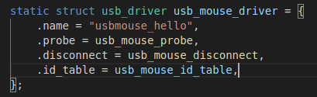
Trace the original USB HID mouse driver & Try to write your own one
Write comments for each section or line of code in the original USB HID mouse driver.
The path of original USB HID mouse driver is
->linux-5.9.2/drivers/hid/usbhid/usbmouse.c
After writing your own one, leave comments as well
DO NOT COPY AND PASTE -> ZERO POINT IN THIS HW
Add printk in your own driver for reporting left button click.
Remember to change the name in this struct as well.
3
Notes:
Here is more detail about me. I started working as a postdoctoral research fellow at the Institute of Information Science, Academia Sinica since March 2018
During my fellowship, I have been to the Purdue University USA and the Chinese University of Hong Kong for visiting
Before my fellowship, I spent two and half years for my phd degree at the CS Department of National Tsing Hua University
My research interests mainly lies in
the next generation memory/storage architecture designs
Emerging non-volatile memory and storage technologies
Low power system designs for artificial neural networks
In the past few years, I have revived few awards and a best paper nomination at DAC conference, which is a top rated conference in the EDA field

Slide 4
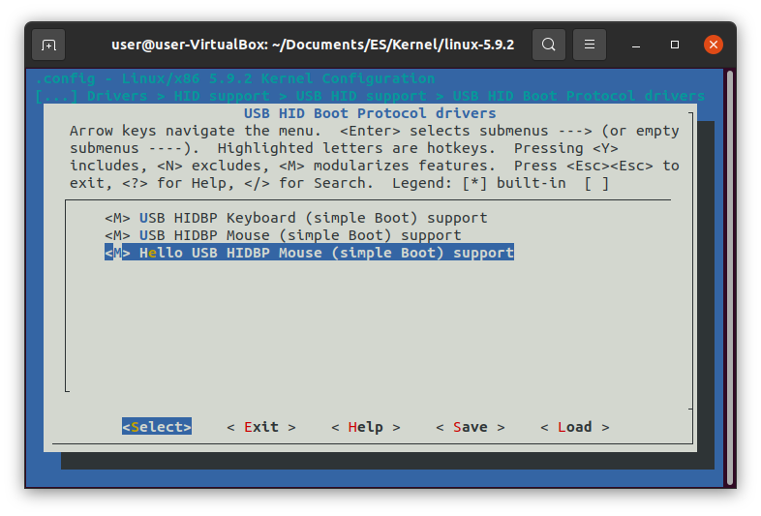
Add your own driver to Menuconfig like HW03 & compile/install kernel.
Alter linux-5.9.2/drivers/hid/usbhid/Kconfig & Makefile like HW03.
So you will see something like this
in Menuconfig.
(You may change it to other names.)
Check the module you add as <M>. The Path in Menuconfig is: Device Drivers->HID support ->USB support ->USB HID Boot Protocal drivers
Use $make to recompile your kernel
After recompile your kernel, in your Linux Kernel source folder
sudo make modules_install
sudo make install
4
Notes:
Here is more detail about me. I started working as a postdoctoral research fellow at the Institute of Information Science, Academia Sinica since March 2018
During my fellowship, I have been to the Purdue University USA and the Chinese University of Hong Kong for visiting
Before my fellowship, I spent two and half years for my phd degree at the CS Department of National Tsing Hua University
My research interests mainly lies in
the next generation memory/storage architecture designs
Emerging non-volatile memory and storage technologies
Low power system designs for artificial neural networks
In the past few years, I have revived few awards and a best paper nomination at DAC conference, which is a top rated conference in the EDA field

Slide 5
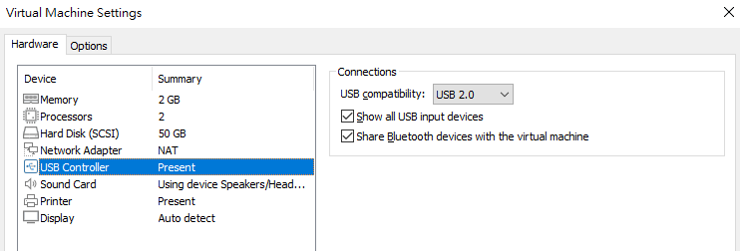
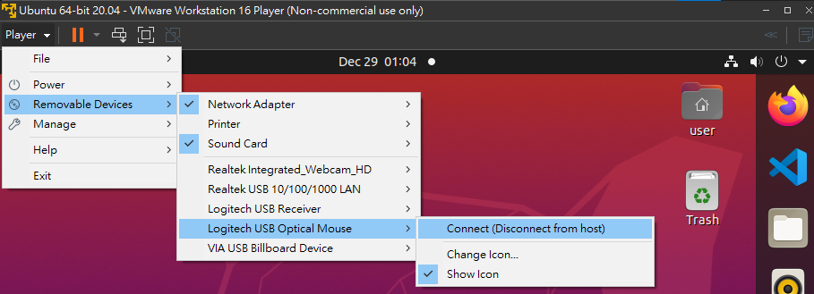
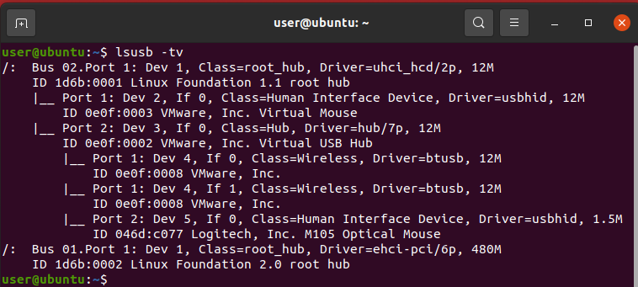
Prepare a second mouse & add it to VMware virtual machine.
Completely shutdown(not suspend) the virtual machine.
Check the <Show all USB input devices> settings.(Pic A)
Reboot the virtual machine, connect your second mouse like picture B.
Use $lsusb -tv to check your mouse and the driver it is binded with now. (Pic C)
A
B
C
5
Notes:
Here is more detail about me. I started working as a postdoctoral research fellow at the Institute of Information Science, Academia Sinica since March 2018
During my fellowship, I have been to the Purdue University USA and the Chinese University of Hong Kong for visiting
Before my fellowship, I spent two and half years for my phd degree at the CS Department of National Tsing Hua University
My research interests mainly lies in
the next generation memory/storage architecture designs
Emerging non-volatile memory and storage technologies
Low power system designs for artificial neural networks
In the past few years, I have revived few awards and a best paper nomination at DAC conference, which is a top rated conference in the EDA field

Slide 6

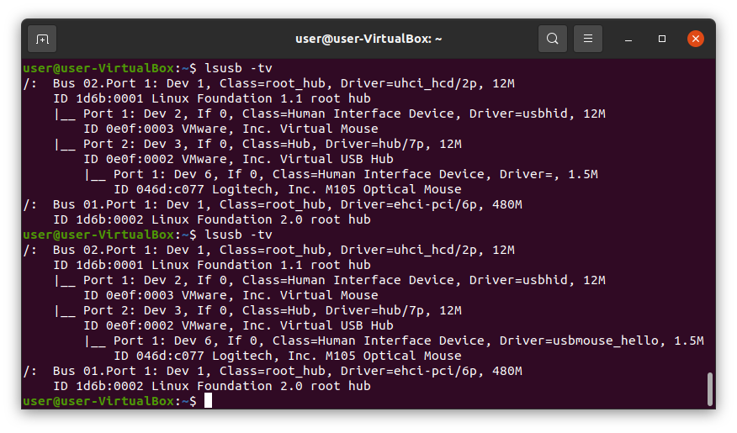
Unbind the original driver & bind you own one to your second mouse.
If you haven’t set the password of root, use $sudo passwd root to set it. We will need it later.
Use $lsmod to check whether your driver is loaded or not. If it isn’t, use $modprobe <module name> to load it.
Use $dmesg to find your second mouse’s “usbid”(Pic A).
A
Use $su - to change account to root.
$echo -n “usbid” /sys/bus/usb/drivers/usbhid/unbind to unbind your second mouse with original driver.(Pic B)
$lsusb -tv to make sure you unbind second mouse driver successfully.(Pic C) Your second mouse should be unusable now.
$echo -n “usbid” /sys/bus/usb/drivers/<your driver’s name>/bind to bind your driver.(Pic B)
$lsusb -tv to make sure you bind your own driver successfully.(Pic C) Your second mouse should work now.
C
B
6
Notes:
Here is more detail about me. I started working as a postdoctoral research fellow at the Institute of Information Science, Academia Sinica since March 2018
During my fellowship, I have been to the Purdue University USA and the Chinese University of Hong Kong for visiting
Before my fellowship, I spent two and half years for my phd degree at the CS Department of National Tsing Hua University
My research interests mainly lies in
the next generation memory/storage architecture designs
Emerging non-volatile memory and storage technologies
Low power system designs for artificial neural networks
In the past few years, I have revived few awards and a best paper nomination at DAC conference, which is a top rated conference in the EDA field

Slide 7
Requirement of this Homework
Submit your source code and screenshot of your dmesg
The original USB HID driver with all your comments
The USB HID driver wrote with comments
File naming
The first -> USB_109000000_original.c
The second -> USB_109000000.c
Your report -> ES_HW04_109000000.pdf
Your video -> 109000000.mp4 (Or other video format is fine as well, just make sure it is playable. Be ware of the limit of uploading file at iPlus.(64MB))
Upload 4 files separately.
7
Notes:
Here is more detail about me. I started working as a postdoctoral research fellow at the Institute of Information Science, Academia Sinica since March 2018
During my fellowship, I have been to the Purdue University USA and the Chinese University of Hong Kong for visiting
Before my fellowship, I spent two and half years for my phd degree at the CS Department of National Tsing Hua University
My research interests mainly lies in
the next generation memory/storage architecture designs
Emerging non-volatile memory and storage technologies
Low power system designs for artificial neural networks
In the past few years, I have revived few awards and a best paper nomination at DAC conference, which is a top rated conference in the EDA field

Slide 8

Q & A
Remember to submit your report.
Deadline is set to 1/7 24:00 !
Late submission will be not accepted !
Notes:
Thank you for listening. Now, I would like to end today’s talk by the Q & A time.

